Slide 1

Smart Cards (GEMPLUS)

Slide 2
Smart Cards
Used to enhance the security and authentication process on HSBCnet
A 3rd party provider (GEMPLUS) was chosen by HSBC for the packaged solution
The Smart Cards and Card Readers are sent from GEMPLUS directly to customers
HSBCnet users with System Administration or Transacting entitlements will require a Smart Card. Those with Enquiry entitlements will not need one.
Software installation on workstation required
Notes:
HSBC IT teams developed HSBCnet, and all the applications within, to work with the GEMPLUS security solution.

Slide 3
Smart Cards
Example of Tools that require Smartcards:
System Administrators: Staff Users:
  User Management User Management
  Registration Status Registration Status
  Account Management Customer Management
End Users:
  Authorisation Summary
  File Upload
  ITS (Trade Services)
  e-Securities (Transaction Entry)

Slide 4
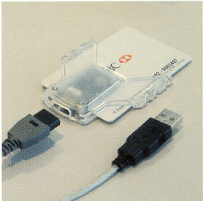
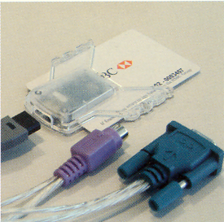
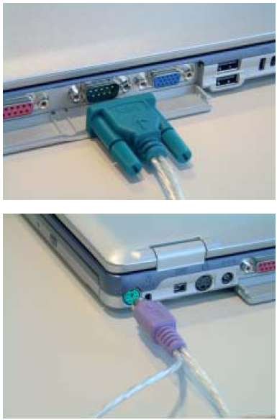
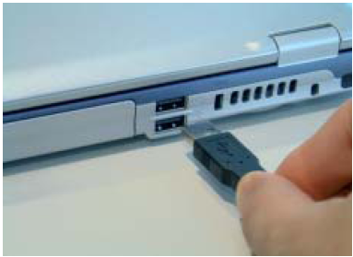
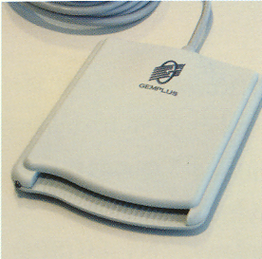
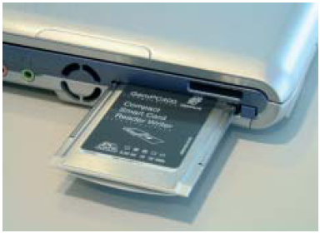
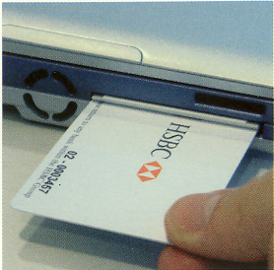
Card Readers
There are 4 types of card readers:
Transparent Twin (requires v4.2)
USB
PCMCIA
Serial/PS2 (discontinued)
Transparent Twin
USB
PCMCIA
Serial/PS2
Notes:
Serial/PS2 – Used by older PCs (not given to new customers anymore)
USB – Used by newer PCs
PCMCIA – Used by Laptops
Transparent Twin – Latest, supports both Serial/PS2 and USB (requires software v4.2 or higher)

Slide 5
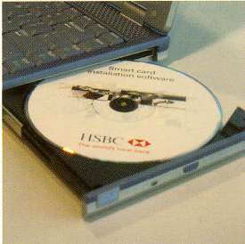
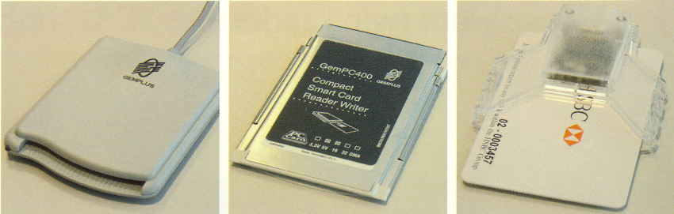
Software
The software CD comes together with the welcome package along with the Smart Card, Card Reader, and a Quick Installation Guide
Follow the instructions on the installation guide to install the software properly

Slide 6
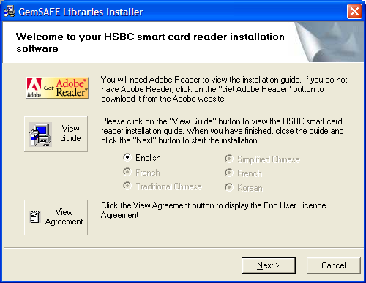
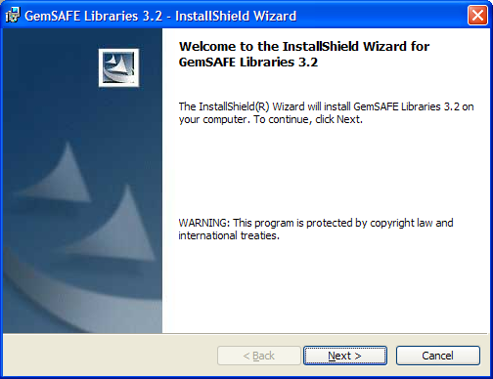
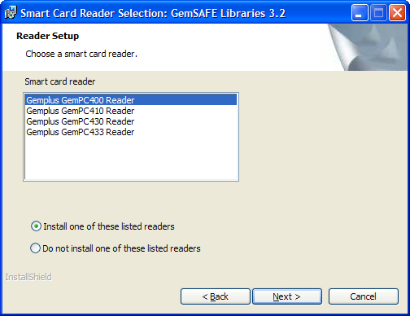
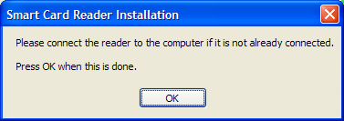
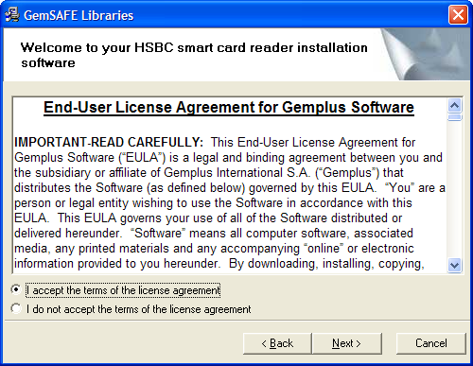
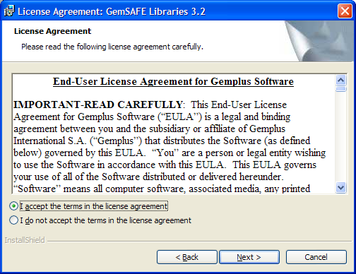
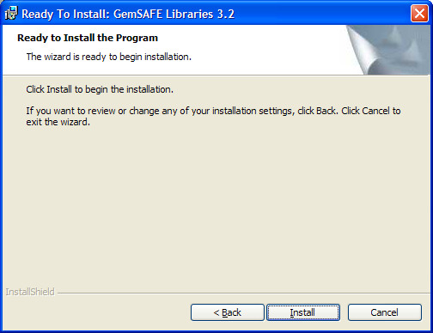
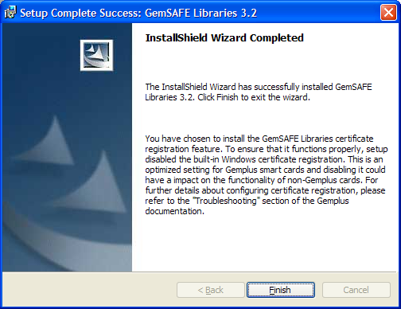
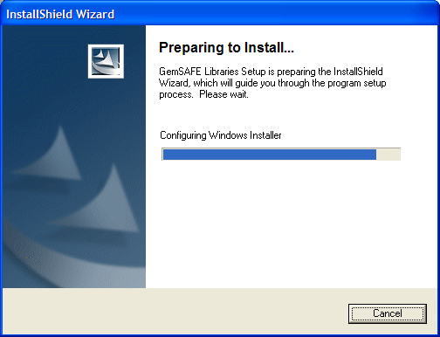
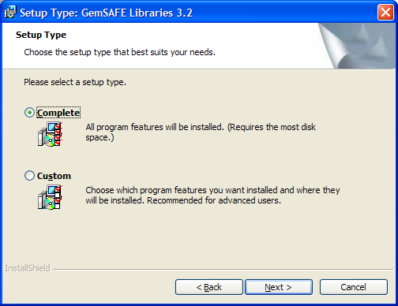
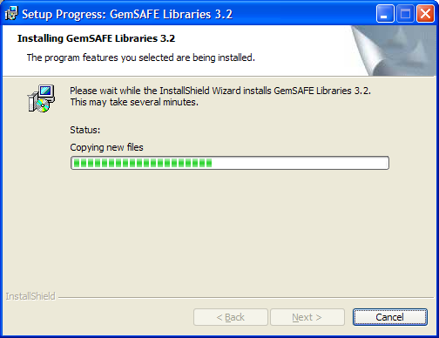
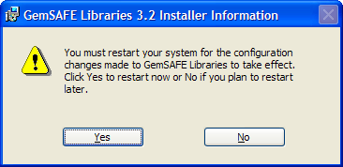
Installation
Select proper Reader Type
Connect Reader to PC
Can view Install Guide
Must Restart PC
Select Complete
Notes:
This is the current version that GEMPLUS is sending to HSBCnet Customers.

Slide 7
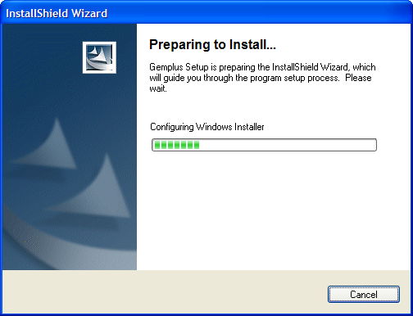
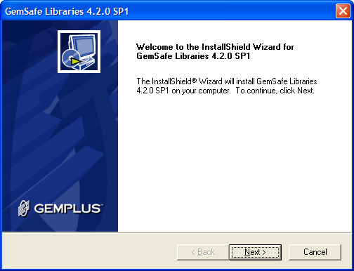
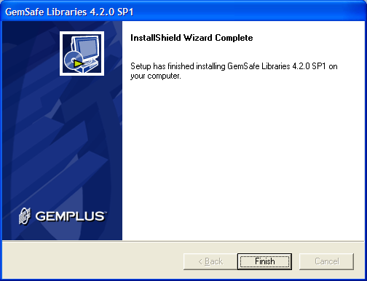
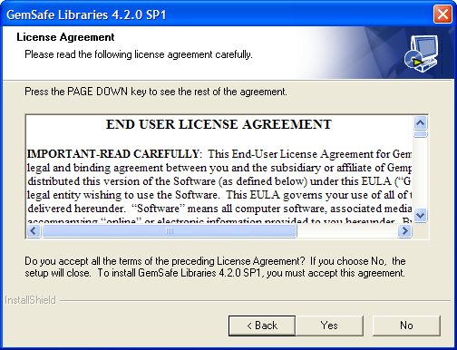
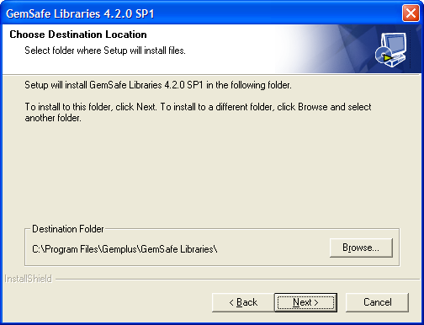
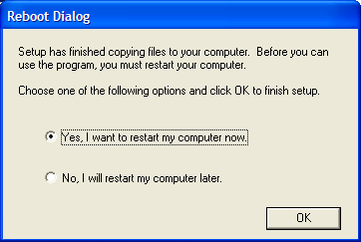
Installation v4.2
Must Restart PC
Notes:
This is the latest version that has been fully tested. However, GEMPLUS has not released this to HSBCnet customers yet for some reasons.

Slide 8
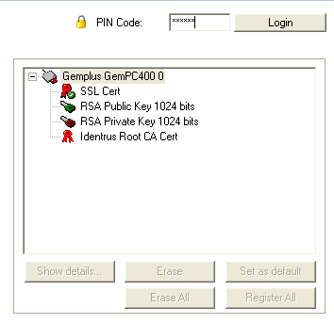
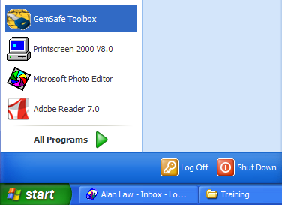
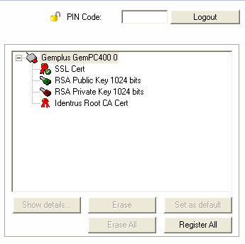
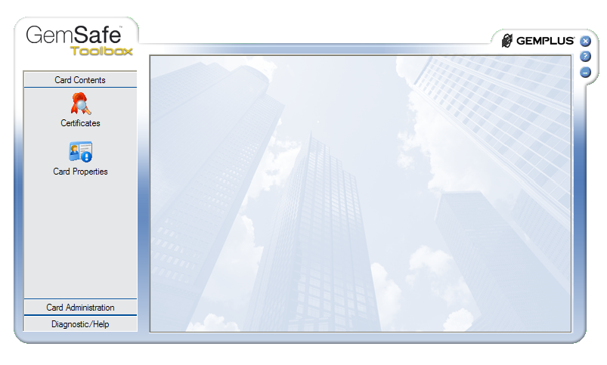
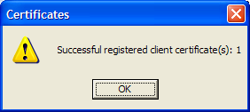
Card Registration
Input the PIN for your Smartcard
Click on Register All
Click on Certificates
Notes:
This is the newest version, the old version looks very different but the setup procedures are the same.
Put the Smartcard into reader before running the GEMPLUS setup application.

Slide 9
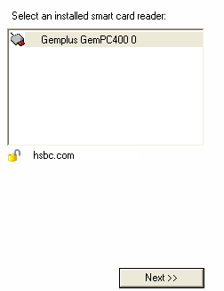
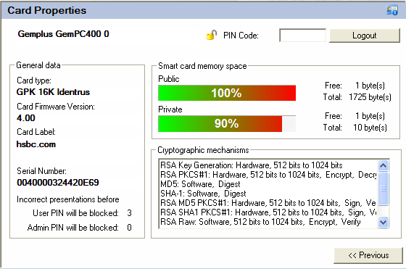
Card Properties
Click on Card Properties
Notes:
Not particularly useful but contains information about your smartcard in case GEMPLUS requires this information for troubleshooting.

Slide 10

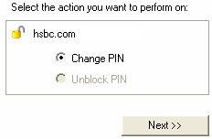
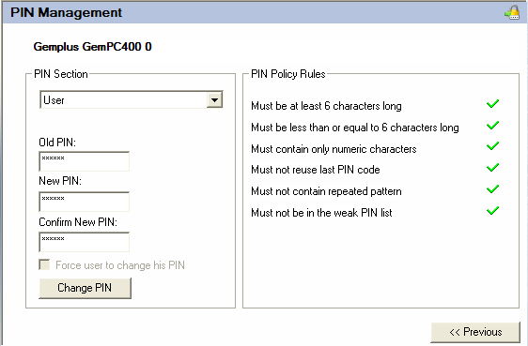
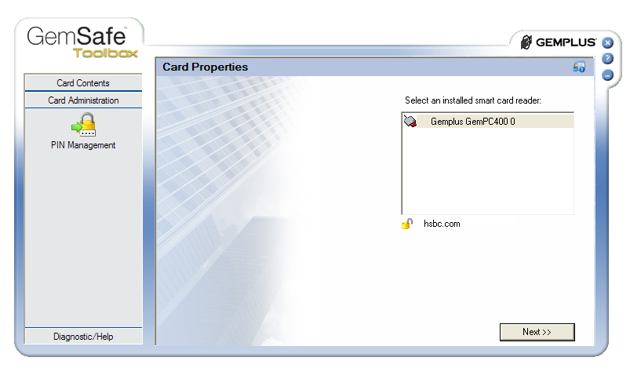
Changing PIN
Input the PIN for your Smartcard
Input the current PIN and input the new PIN twice. Note the PIN has to meet all criteria before you can confirm the changes.
Click on Card Administration and PIN Management
Notes:
This is the newest version, the old version looks very different but the setup procedures are the same.
Put the Smartcard into reader before running the GEMPLUS setup application.

Slide 11
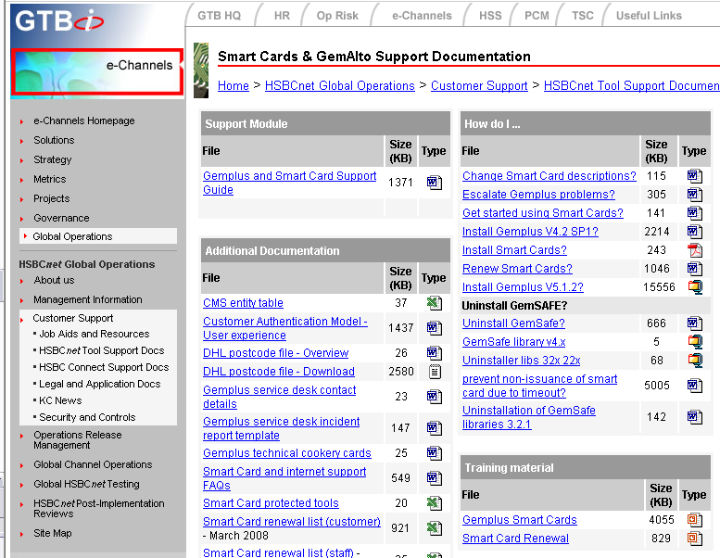
Support
Smart Card / GEMPLUS support materials can be found on the Intranet under the KC Tools Support Document section.
Support Documents
Notes:
Further details and guidelines can be found on the KC Intranet. Staff should follow them and guide customers accordingly.
Query escalation - to Level 2 support - if required they will contact GEMPLUS help desk. If required, Craig Sandiford to be contacted by Team Leader/Manager to escalate query to Maxine George in GEMPLUS. Craig Sandiford is responsible for the GEMPLUS Contract.

Slide 12
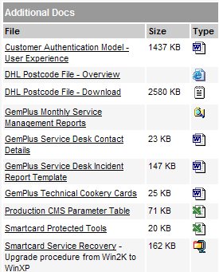
Support
CMS Parameter Table – Country and Institution required to be inputted to allow staff and customer requests to be processed. This is also under the KC Tools Support Document section.
Production CMS Parameter Table
Notes:
CMS Parameter file – This is maintained by the CMS team in New Jersey (USA). It is not part of SHex or HSBCnet. But, if this file is not updated, customers and staff will be unable to process requests for users in the institution/country in question (will receive “SUAVALERR102” error message).
Any new support areas set up need to ensure that their required entries are included in the CMS file.

Slide 13
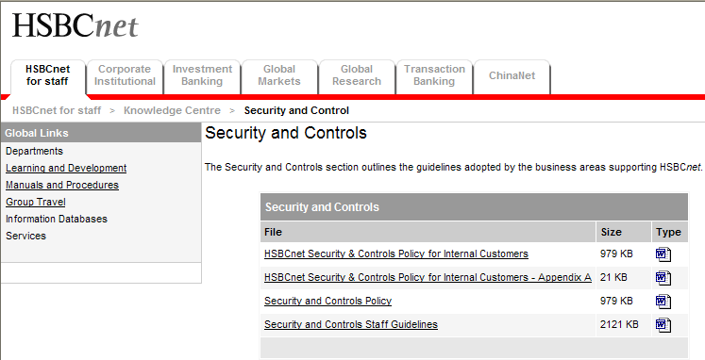
Support
HSBCnet Guidelines and Policies for Staff and Internal Customers can be found under the KC Security and Controls section.
Security and Control Documents

Slide 14
Support
Installation and Setup problems should be escalated to the KC level 2 team. They will contact the GEMPLUS helpdesk directly.
Postal Codes inputted onto the system – DHL uses them to determine the closest Airport only. It’s not used for delivery purposes. The Postal Code file is updated every 3 months. Therefore, could be out of date.

Slide 15
Troubleshooting
PC does not detect smart card reader
  Wrong smart card reader selected for installation
No icon shown in the system tray
  Computer was not rebooted after installation
‘You did not present a valid certificate’ error message
  Smart card not inserted properly (upside down, not all the way in)
‘The page cannot be displayed’ error message
  Wrong PIN input or did not allow 5 seconds before clicking on Continue. Log off, Close Browser, and Login again to HSBCnet.
‘ No smartcard reader found. CertReg will not work’ error message
  Installation problem, uninstall and reinstall again
Notes:
Windows Plug N Play will NOT work for HSBCnet smart card readers! Need to run the GEMPLUS software and install the proper drivers and utilities.

Slide 16
Troubleshooting
‘Please enter a valid null (SUAVALERR102)’ error message
  Name contains ‘ eg O’Brien
  Invalid Post Code Range - Post Code updated every 3 months - could be slightly out of date. Use post code in vicinity - only used by DHL for nearest airport not for delivery purposes.
Smart card locked
  Smart card has been revoked/replaced
  Incorrect PIN entered more than 3 times when using GemSAFE utility
  Request System Administrator / KC to Replace Smartcard.
PIN not received (traceable through DHL website)
Lost PIN number (request new smart card)
Red X shown across the smart card reader icon in system tray
  Installation problem, uninstall and reinstall again

